Slide 1
Multiple users on Powered Shoes
Elective in Robotics
Locomotion and Haptic Interfaces
A.Y. 2020/2021
Examinees
Rossella Bonuomo, 1923211
Marco Pennese, 1749223
Veronica Vulcano, 1760405
Professor
Alessandro De Luca

Slide 2
TABLE OF CONTENTS
1
3
5
INTRODUCTION
IMPLEMENTATION
CONCLUSION
2
4
Introduction to Powered Shoes and goal of the project
Description of the code and implementation setting
Final comments
CONTROL DESIGN
EXPERIMENTS
Description of the controller, kinematic model and observer
Presentation of the simulations and results

Slide 3

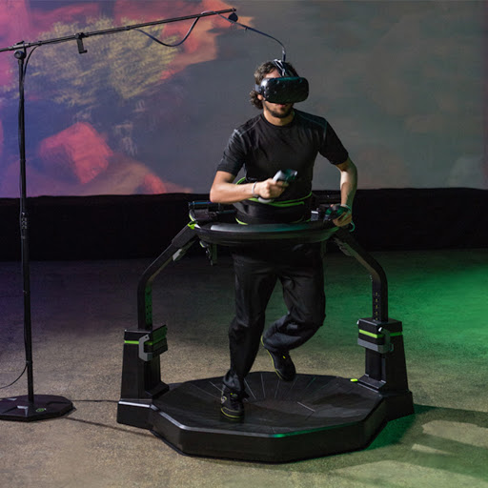
INTRODUCTION
In virtual environment applications, users need a good sense of movement.
Interface devices like treadmills and carpets are used to create infinite surfaces for walking but require cumbersome drive mechanisms.

Slide 4
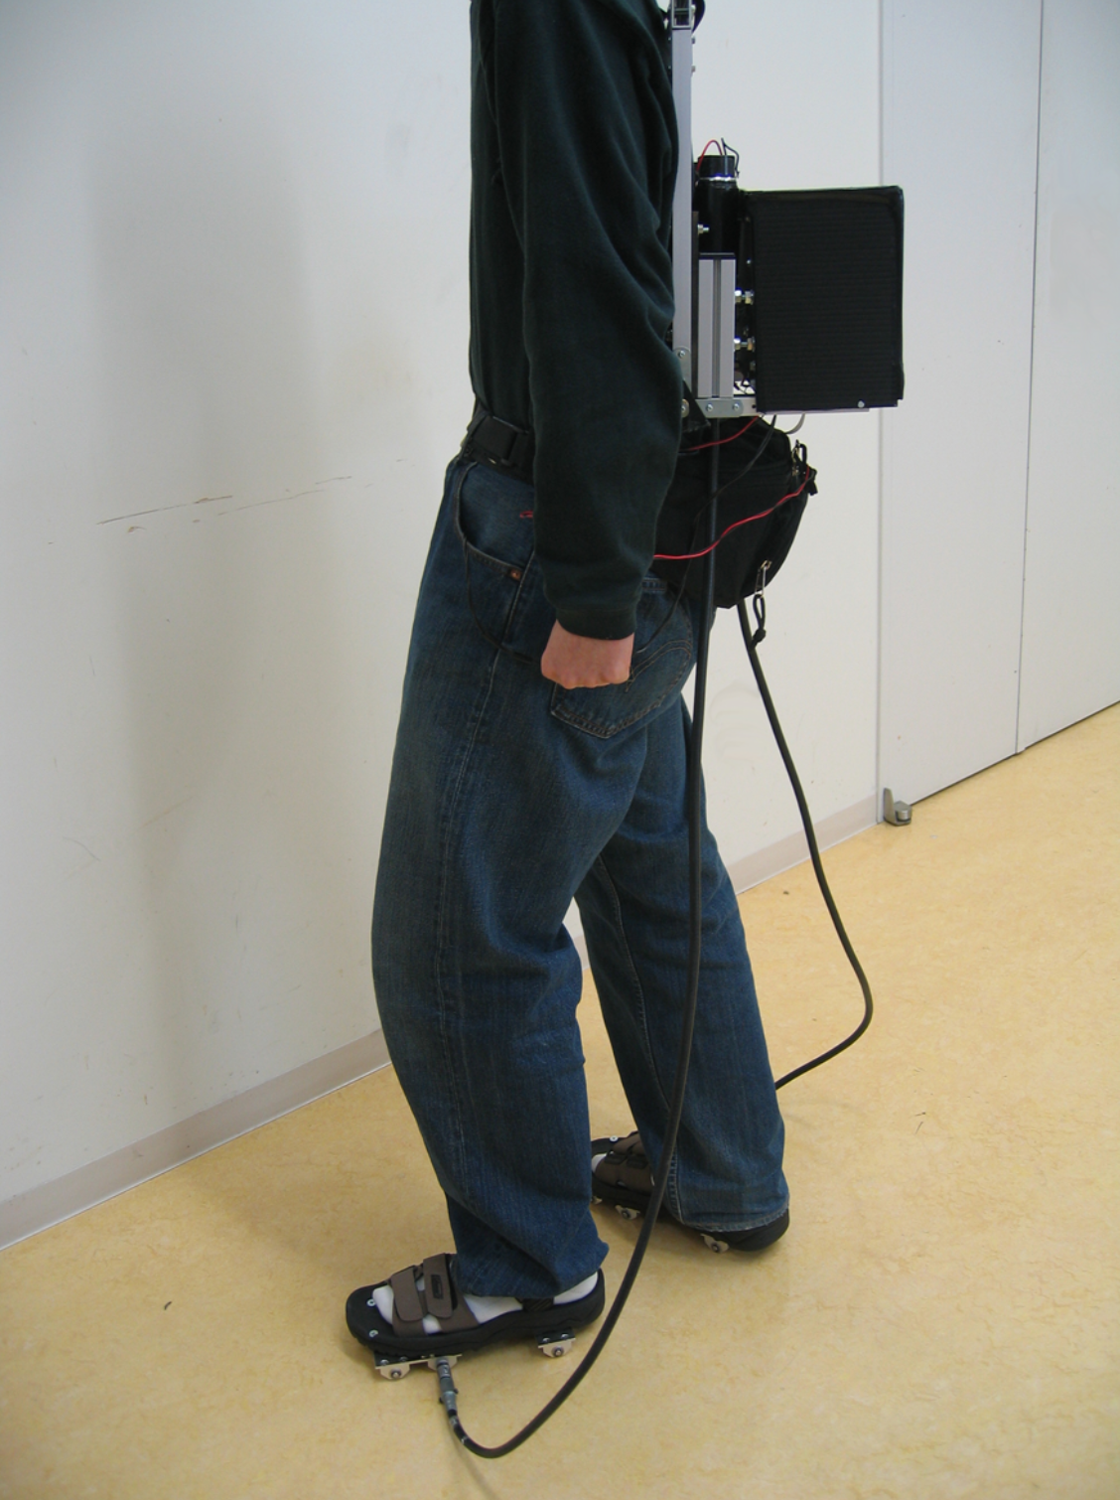
INTRODUCTION
The aim of the Powered Shoes Project is to provide motor-driven roller skates in order to develop a wearable locomotion interface that enables users to walk in all directions while maintaining their position.
We implement a system of users wearing the Powered Shoes moving in a room of limited size.
Each user needs to avoid both the other users and the walls of the room.
To achieve this, a velocity-level decentralized control, based on Artificial Potential Fields is used.

Slide 5
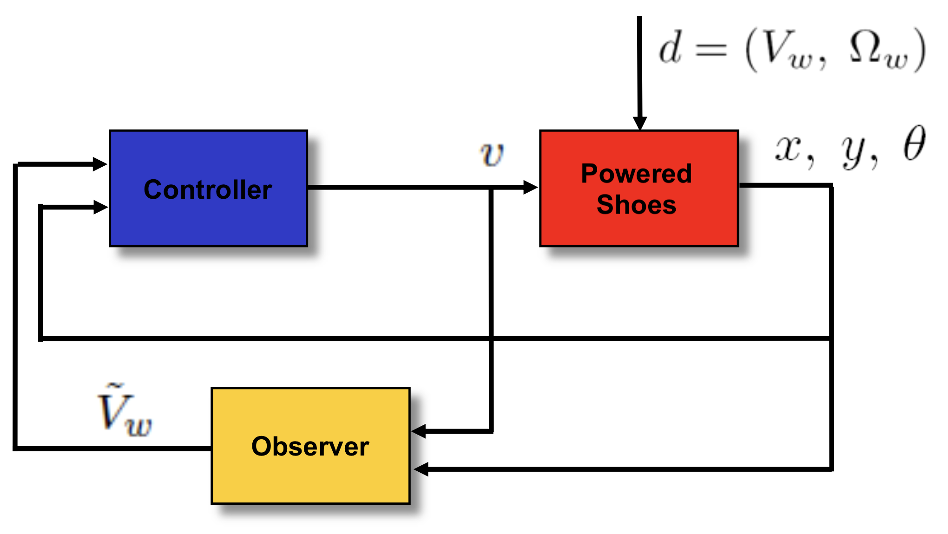
CONTROL DESIGN
The position of each user is measured by sensors.
Each user has a certain intentional velocity to move throughout the virtual environment.
The Powered Shoes must cancel the motion of the steps by moving in the opposite direction of the walker with respect to the measured one.

Slide 6

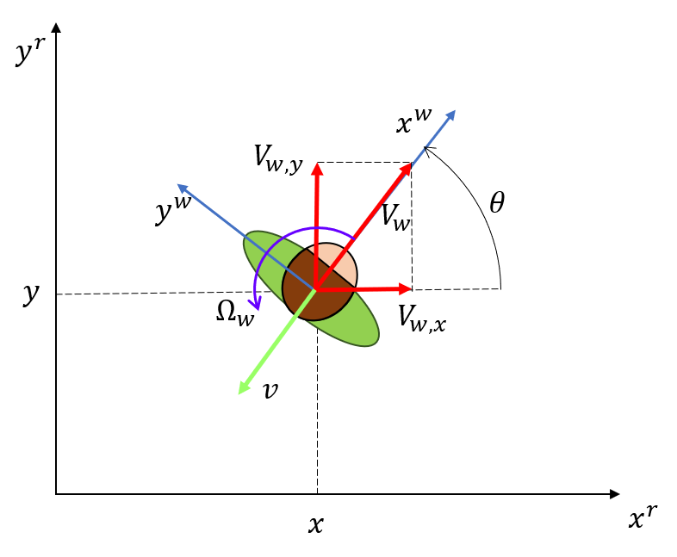
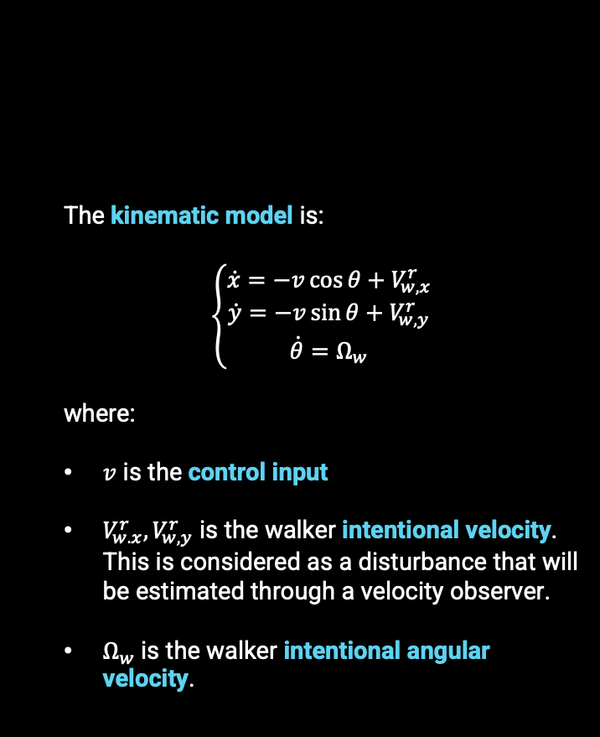

Kinematic Model
The state of the walker is given by
$q=[\begin{matrix}x & y & θ\end{matrix}]$
The kinematic model is:
:
$$\left\{\begin{aligned}\dot{x}=−v\cos{θ}+V_{w,x}^{r} \\ \dot{y}=−v\sin{θ}+V_{w,y}^{r} \\ \dot{θ}=Ω_{w}\end{aligned}\right.$$
where:
$v$ is the control input
$V_{w.x}^{r}, V_{w,y}^{r}$ is the walker intentional velocity. This is considered as a disturbance that will be estimated through a velocity observer.
$Ω_{w}$is the walker intentional angular velocity.
{
position of the walker in the room frame
angle between the walker frame and the room frame

Slide 7
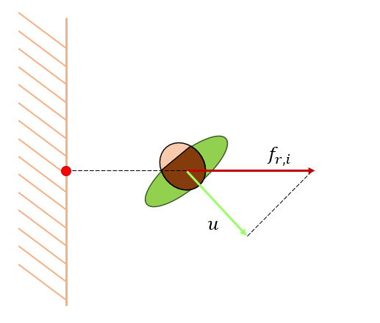

Controller
The controller is given by:
$$v=v_{ff}+u$$
Feed-forward term that considers the intentional velocity of the user
Command given by the Artificial Potential Field
Artificial Potential Fields are a method to perform reactive navigation in which a stimulus response paradigm is built: each user and each wall of the room produce a repulsive potential to move the user away from the obstacles. The repulsive force is given by:
$$f_{r,i}\left(q\right)=−∇U_{r,i}\left(q\right)=\left\{\begin{aligned}\frac{K_{r,i}}{η^{2}\left(q\right)}{\left(\frac{1}{η_{i}\left(q\right)}−\frac{1}{η_{0,i}}\right)}^{γ−1}∇η_{i}\left(q\right) if η_{i}\left(q\right)≤η_{0,i} \\ 0 if η_{i}\left(q\right)>η_{0,i}\end{aligned}\right.$$
Then, the total force $f_{t}$ is given by the sum of all $f_{r,i}$.
This force will be mapped into generalized velocity using the pseudo-inverse of the robot constraint matrix:
$$u=G^{+}\left(q\right)f_{t}$$
$$u=\left[\begin{matrix}−\cos{θ} & −\sin{θ} & 0\end{matrix}\right]\left[\begin{matrix}f_{x} \\ f_{y} \\ f_{θ}\end{matrix}\right]=−f_{x}\cos{θ}−f_{y}\sin{θ}$$

Slide 8

Controller cont.
The feed-forward term accounts for the intentional velocity of the user that will be estimated through an observer.
We assume that there is an imperfect cancellation of the user motion (steps are recovered about 90%) and there is a directional uncertainty.
Therefore, the final controller will be:
$$v=0.9V_{est}−f_{x}\cos\left(θ\right)−f_{y}\sin{(θ)}$$
Where:
$V_{est}$ is the estimated intentional velocity
$n_{θ}\sim 𝒩(0, 5°)$
When the control input and the intentional velocity are aligned, we set the control input to zero. In that case, the user is able to move away from the obstacle by himself.
There is a saturation value on the velocity and on its variation equal to $±1 m/s$ and $±0.8 m/s^{2}$ respectively.

Slide 9


Velocity observer
We set up an observer that has to converge to the value of the intentional velocity of the walker.
$$\dot{ξ_{x}}=−v\cos{θ}+k_{w}(x−ξ_{x})$$
$${\tilde{V}}_{w,x}=k_{w}(x−ξ_{x})$$
$$\dot{ξ_{y}}=−v\sin{θ}+k_{w}(y−ξ_{y})$$
$${\tilde{V}}_{w,y}=k_{w}(y−ξ_{y})$$
It has the same dynamic as the walker, but we replace the true value of the intentional velocity by a compensating factor made of a gain and the difference between the measured variable and the state of the observer.
The estimate is a first-order stable filter of the intentional walker’s linear velocity. The filtered signal is delayed; the delay depends on the value of $k_{w}.$

Slide 10


Random Velocities Generation
In order to prove that our method is valid, it has to work with all possible user intentional velocities and give the impression that the user can move freely in his ”virtual environment”.
We generated exciting random intentional velocities according to the following formula:
$$f(t)=\sum_{l=1}^{L}{\frac{a_{l,j}}{lω_{f}}sin\left(lω_{f}t\right)−\frac{b_{l,j}}{lω_{f}}cos\left(lω_{f}t\right)}$$
$L= 5$, $ω_{f}= 0.15π$ and all $a_{l,j}$ and $b_{l,j}$ are randomly sampled between −1 and 1 with a uniform distribution.
The function $f(t)$ is scaled and translated in order to fit our extremes value and constraints (e.g., we impose $f(0) = 0$ in order to have that the user starts with zero velocity).

Slide 11
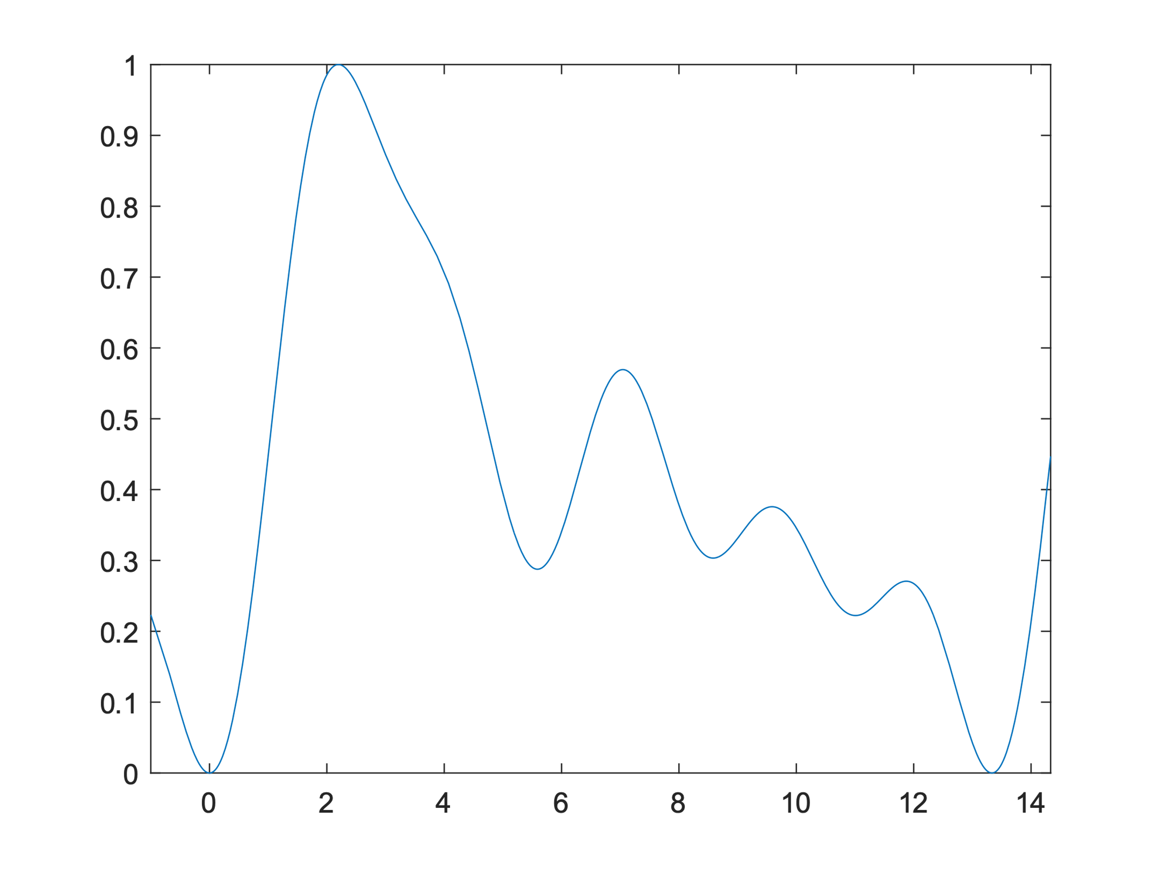
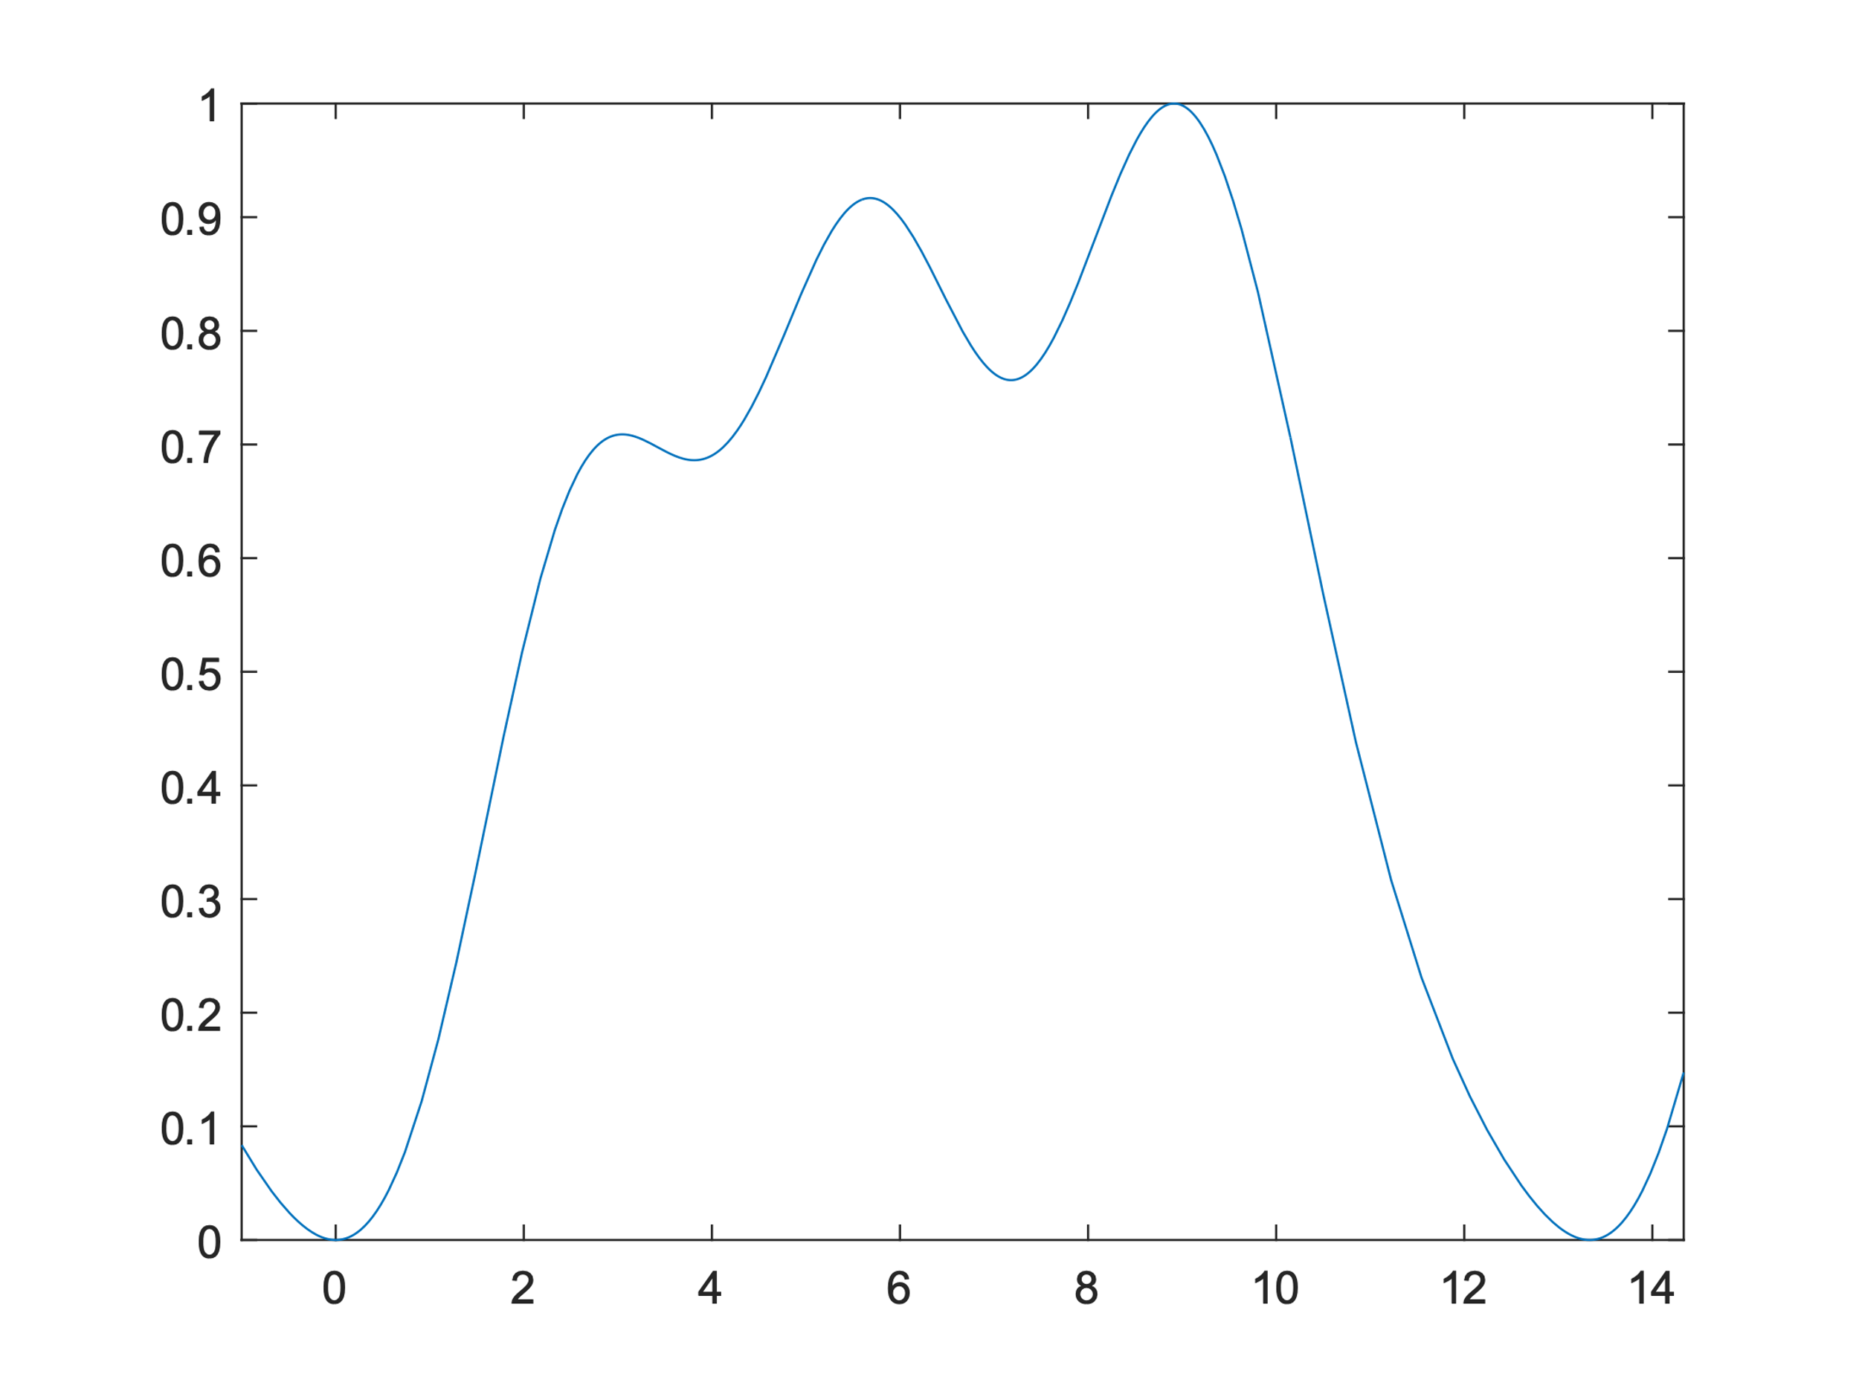
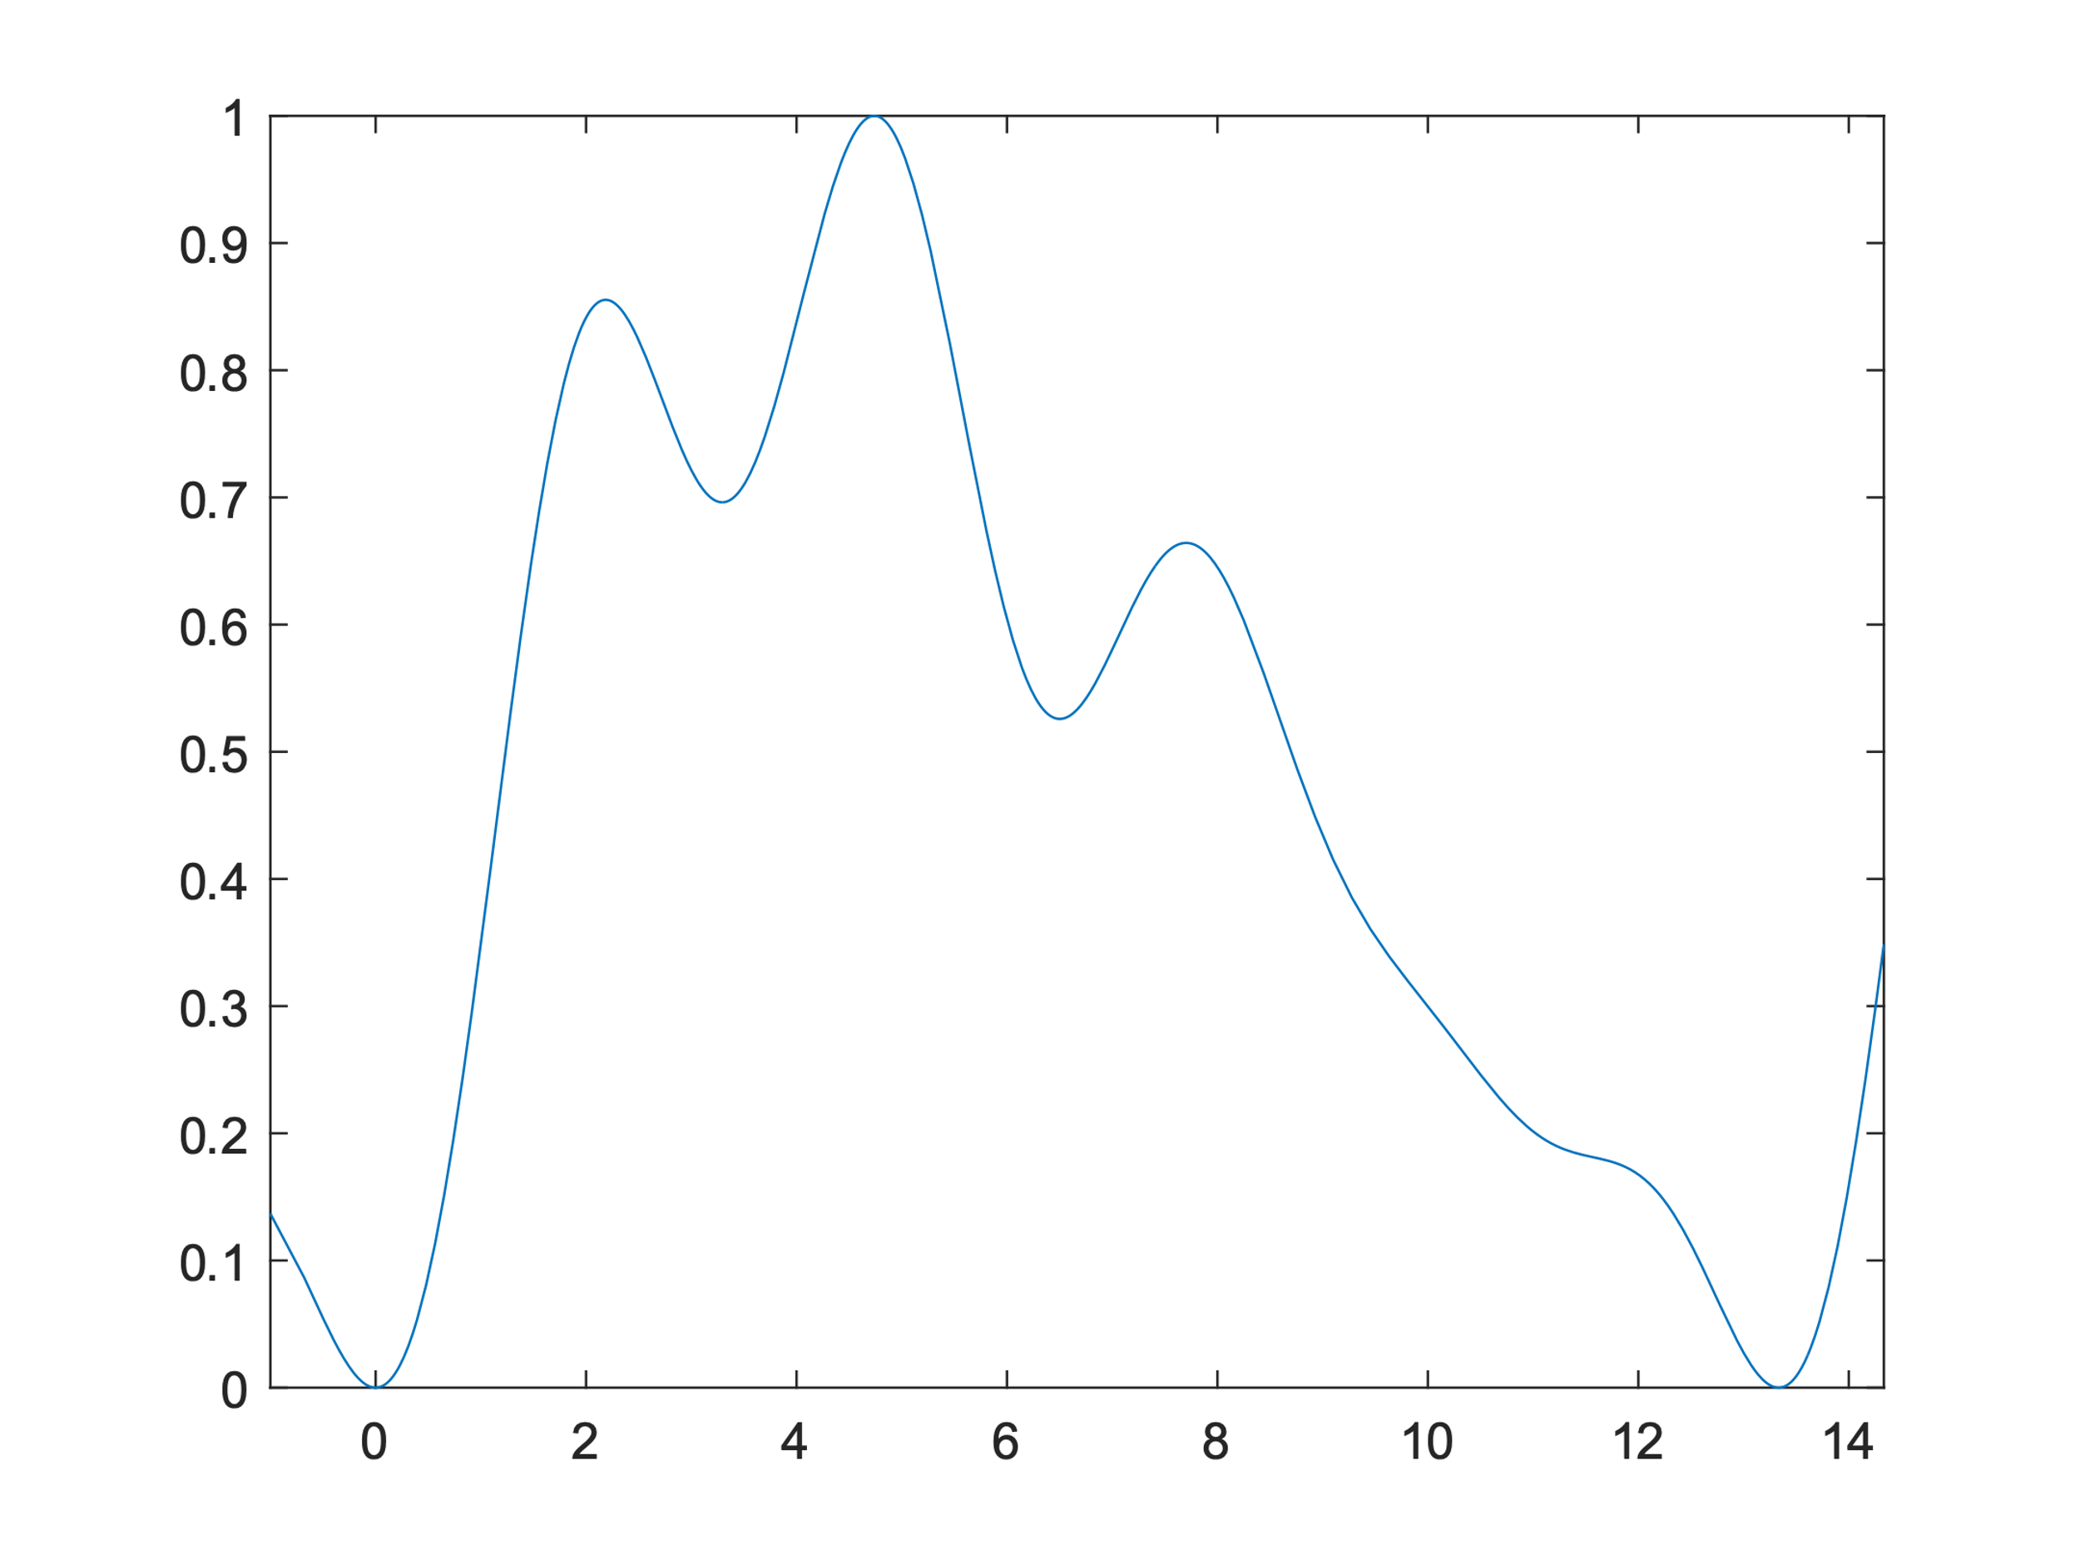
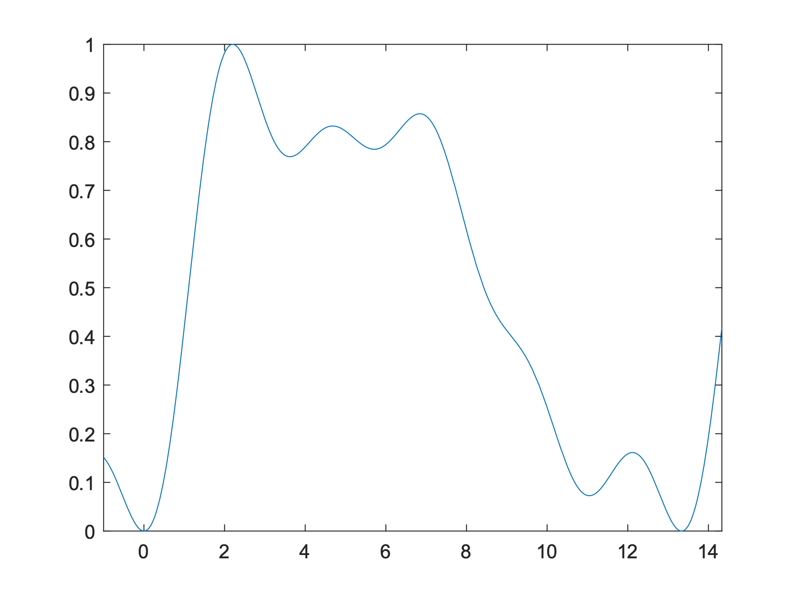

Slide 12
IMPLEMENTATION
ROOM
PERSON WITH SHOES
OBSERVER
The room is a Matlab class instantiated by the walls’ dimension, the initial position of the users, their intentional velocities and other technical parameters.
There are several methods to apply and compute the inputs for all the users.
Each person is a Matlab class, has a specific position and moves with a desired intentional velocity.
The class has a method to determine the user’s position by applying the input and the force due to the artificial potential.
The observer is a Matlab class in which the state is updated at each iteration by considering the discrete version of its equations.
The equations have been discretized using the Euler formulation.

Slide 13

EXPERIMENTS
The time duration of each simulation is $T=30 s$
The sampling time of the controller is $T_{s}=0.1 s$

Slide 14
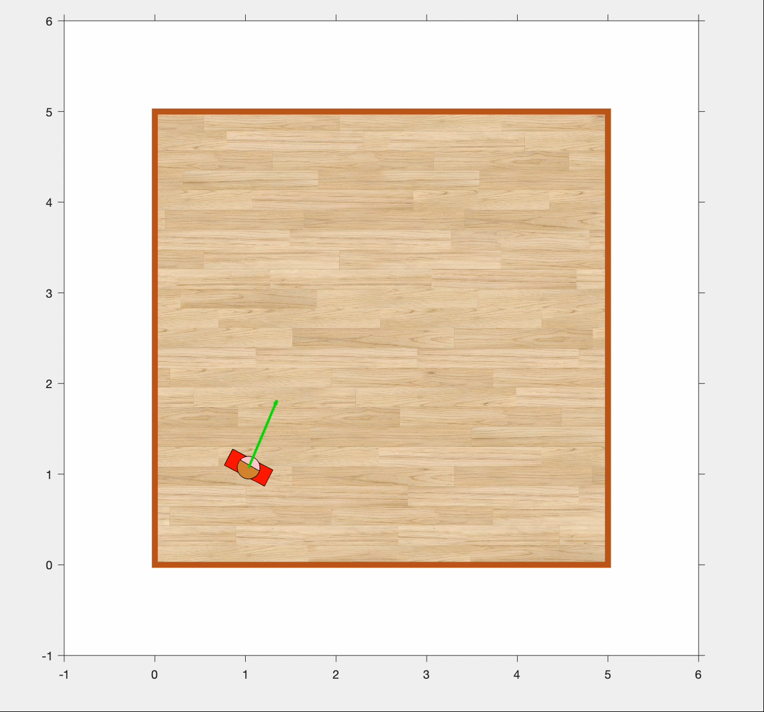

ONE PERSON
Initially, the person is in the lower left part of the room: $q_{i}=\left[\begin{matrix}1 & 1 & π/3\end{matrix}\right]$.
The only obstacles in the computation of the Artificial Potential Field are the walls.
We expect the person to be moved towards the center of the room in order to be equidistant from all the walls. Then, the control input will be such that he will keep that position.

Slide 15
CONTROL VARIABLE
STATE VARIABLES
INTENTIONAL VELOCITY

Slide 16
PROJECTED REPULSIVE POTENTIAL
CLEARANCE

Slide 17
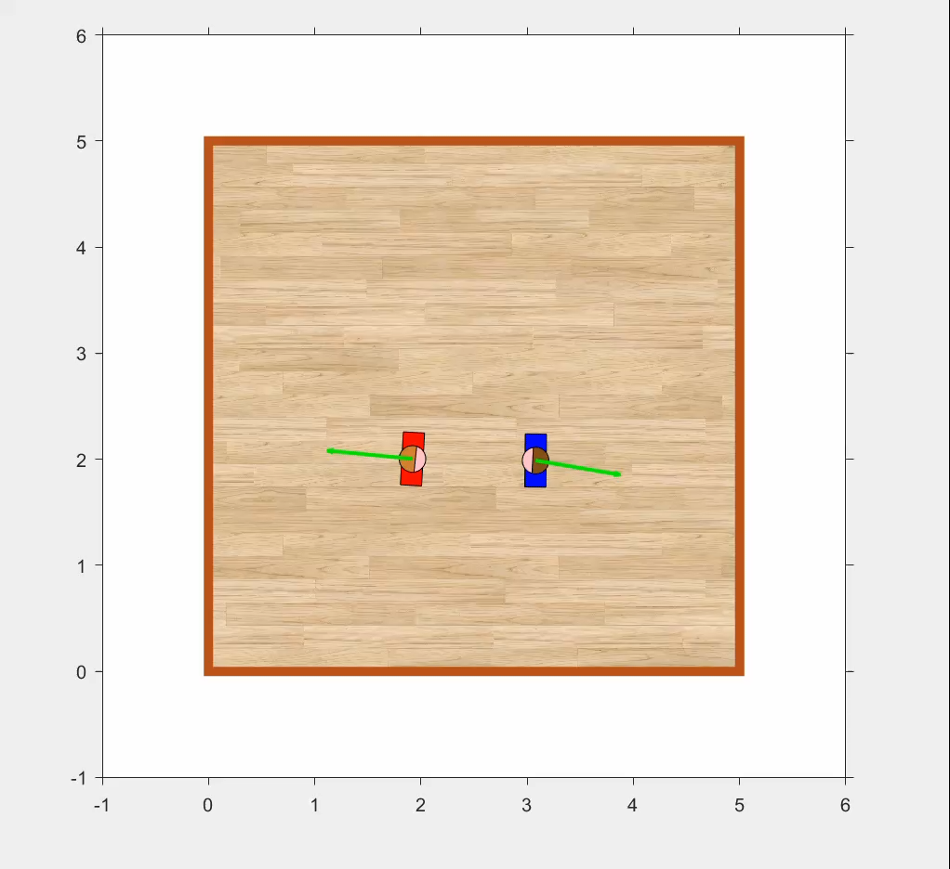

TWO PEOPLE
The initial positions are:
$$q_{1}=\left[\begin{matrix}2 & 2 & 0\end{matrix}\right], q_{2}=\left[\begin{matrix}3 & 2 & −π\end{matrix}\right]$$
The control actions will be such that each people will move only in half of the room; in this case, they are able to avoid each other but also to avoid the walls.

Slide 18
CONTROL VARIABLES
STATE VARIABLES
INTENTIONAL VELOCITIES
Person 1
Person 2

Slide 19
PROJECTED REPULSIVE POTENTIALS
Person 1
Person 2
CLEARANCE

Slide 20
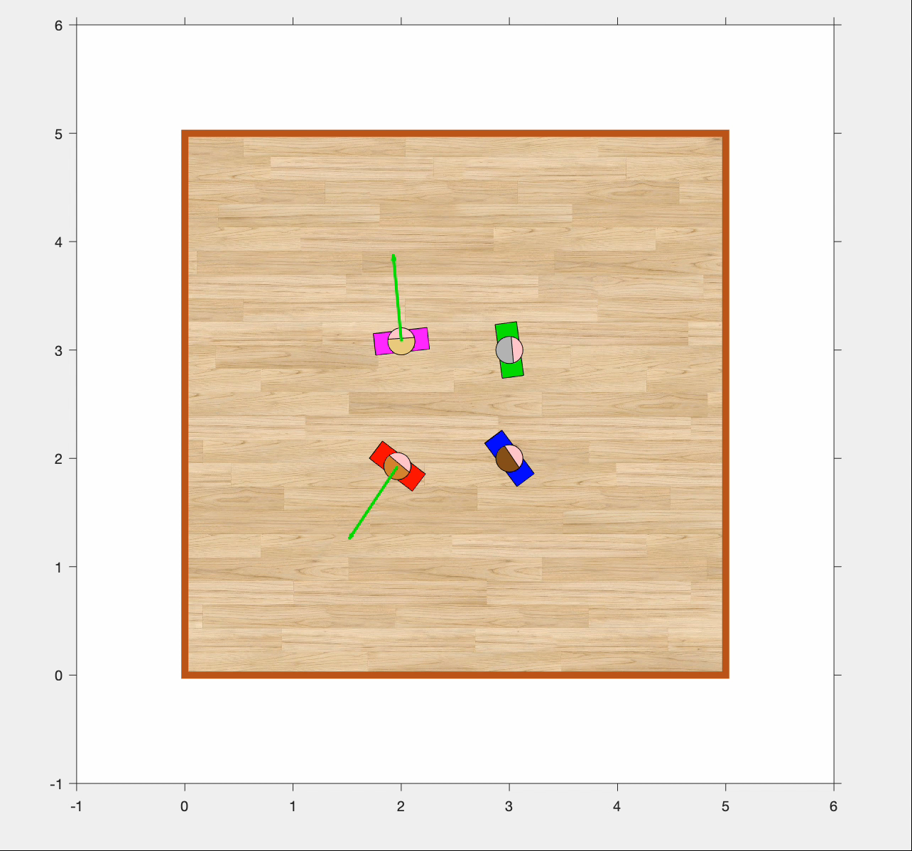

FOUR PEOPLE (no noise)
The initial positions are:
$$q_{1}=\left[\begin{matrix}2 & 2 & \frac{π}{3}\end{matrix}\right]$$
$$q_{2}=\left[\begin{matrix}3 & 2 & \frac{π}{4}\end{matrix}\right]$$
$$q_{3}=\left[\begin{matrix}3 & 3 & 0\end{matrix}\right]$$
$$q_{4}=\left[\begin{matrix}2 & 3 & \frac{π}{2}\end{matrix}\right]$$
They start very close to each other but after few seconds of simulation converge to a position so to be equidistant from the others and from the walls.

Slide 21
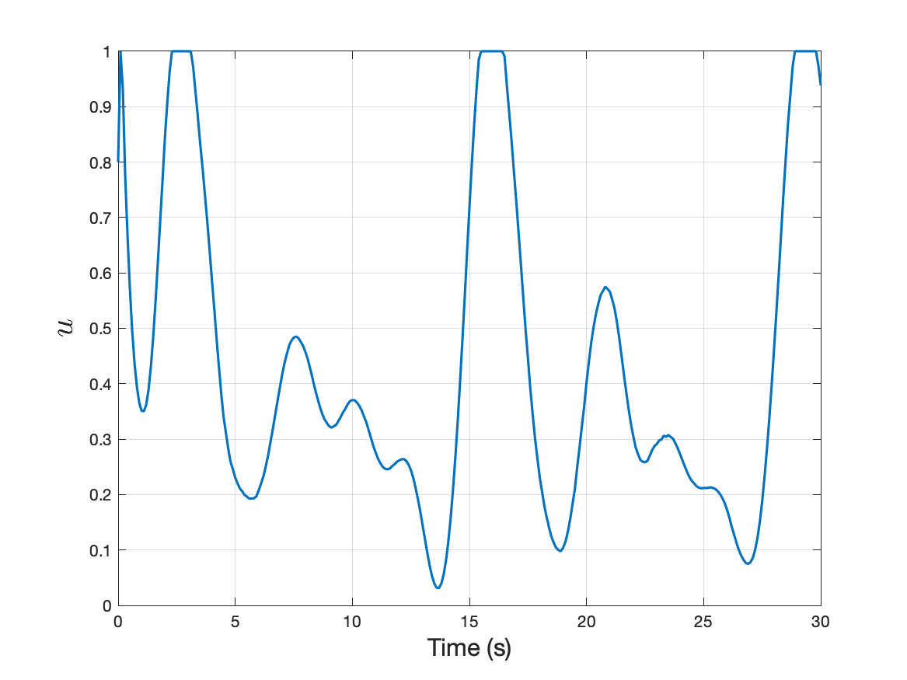
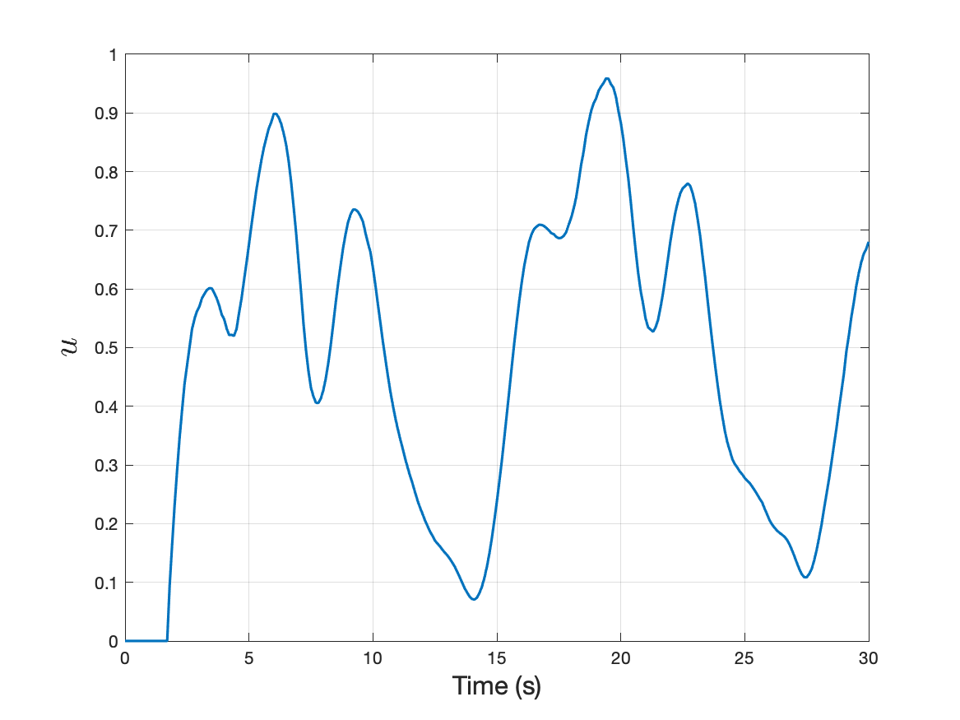
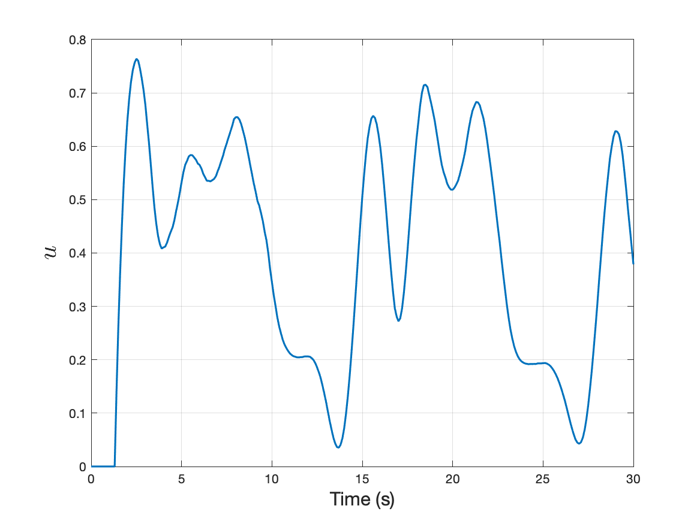
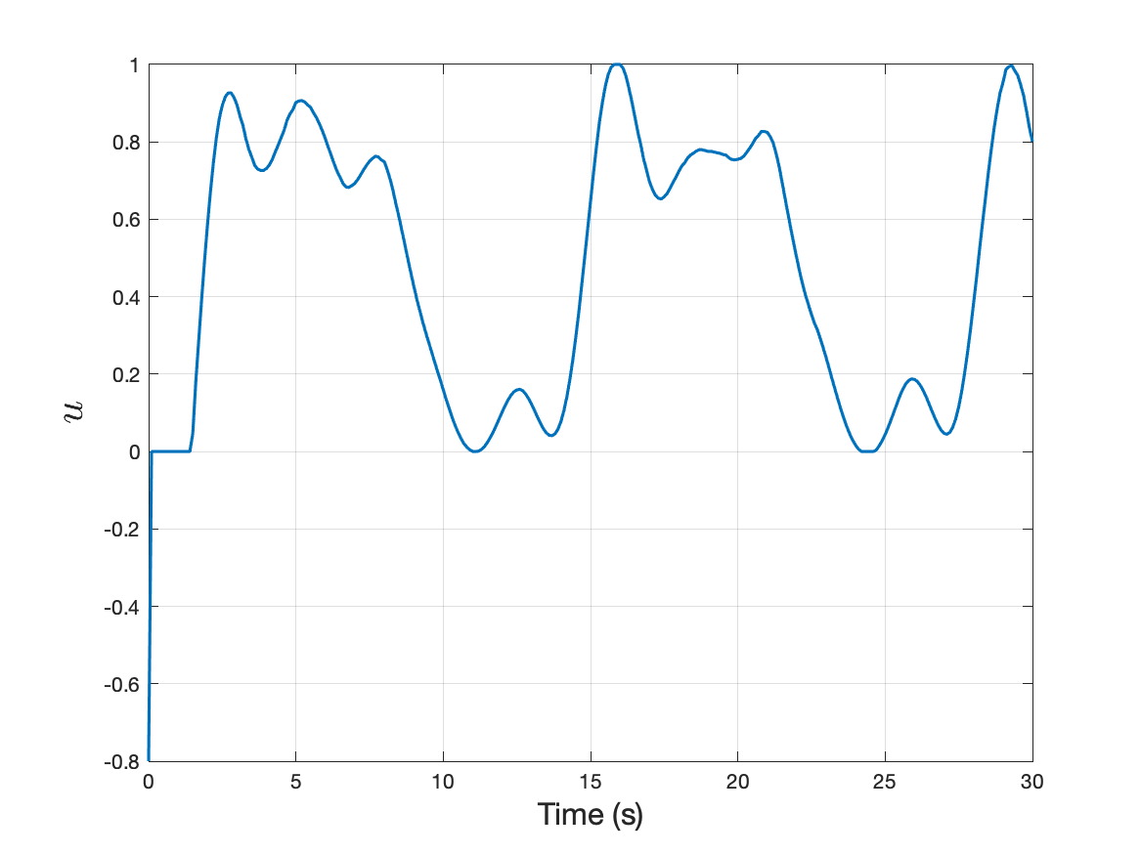
Person 1
Person 2
Control
variables
Person 3
Person 4

Slide 22
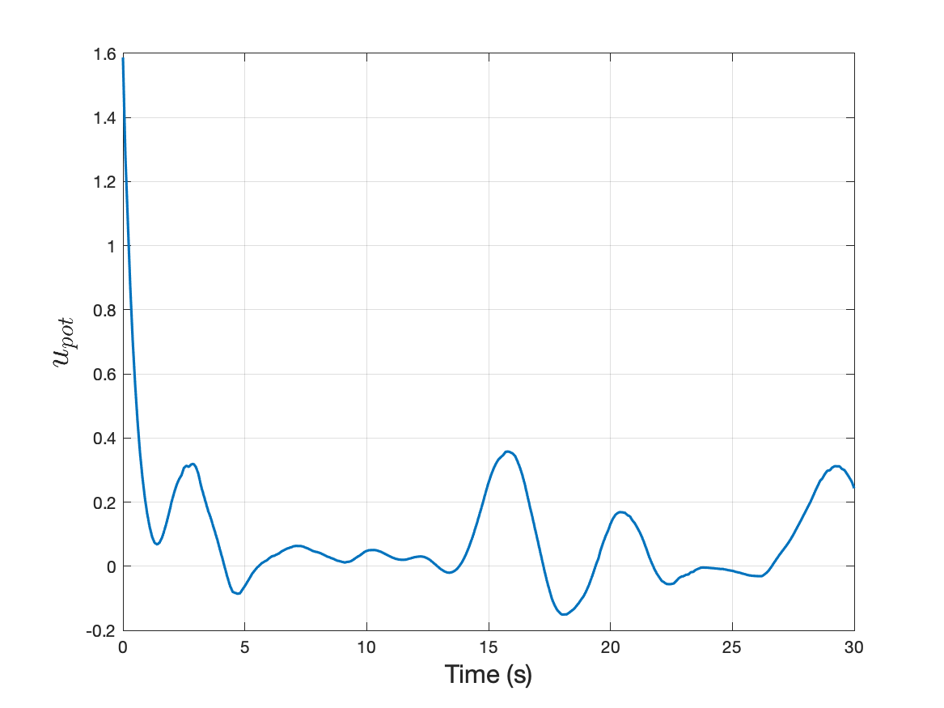
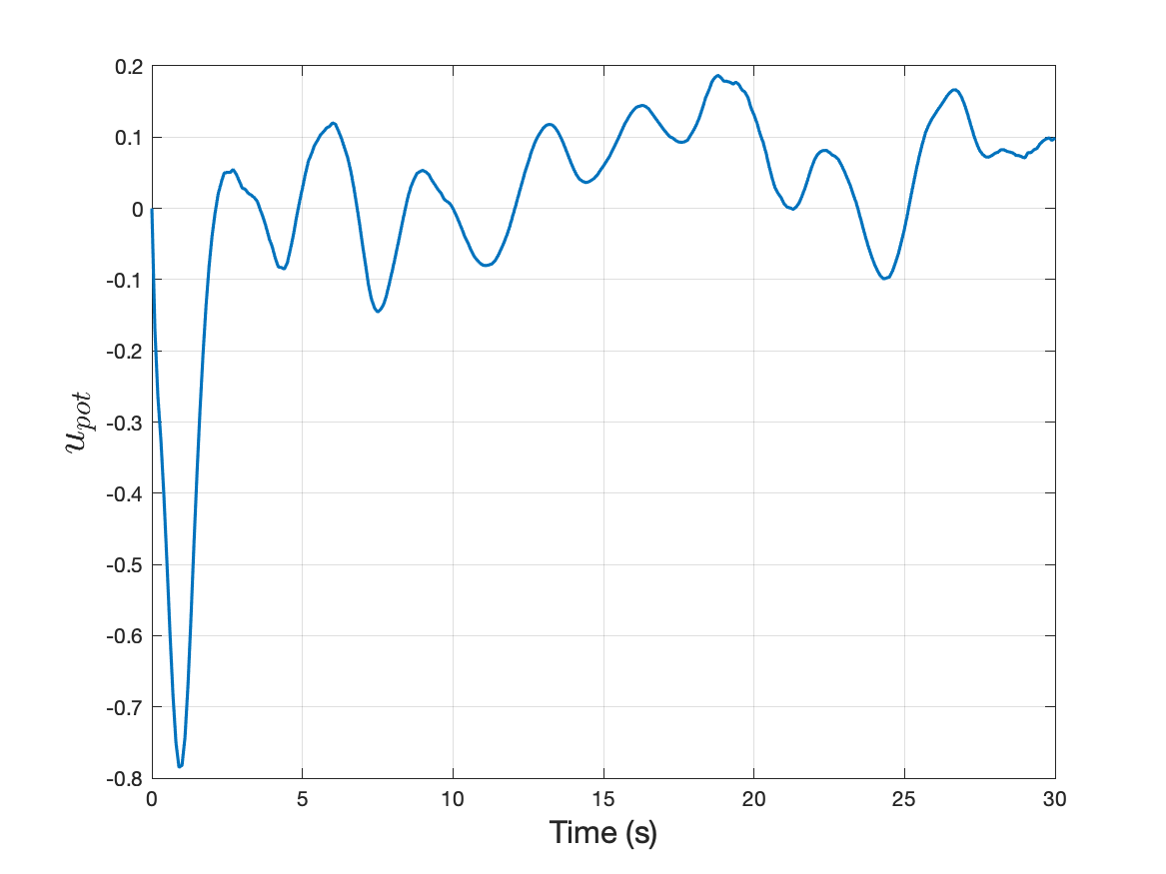
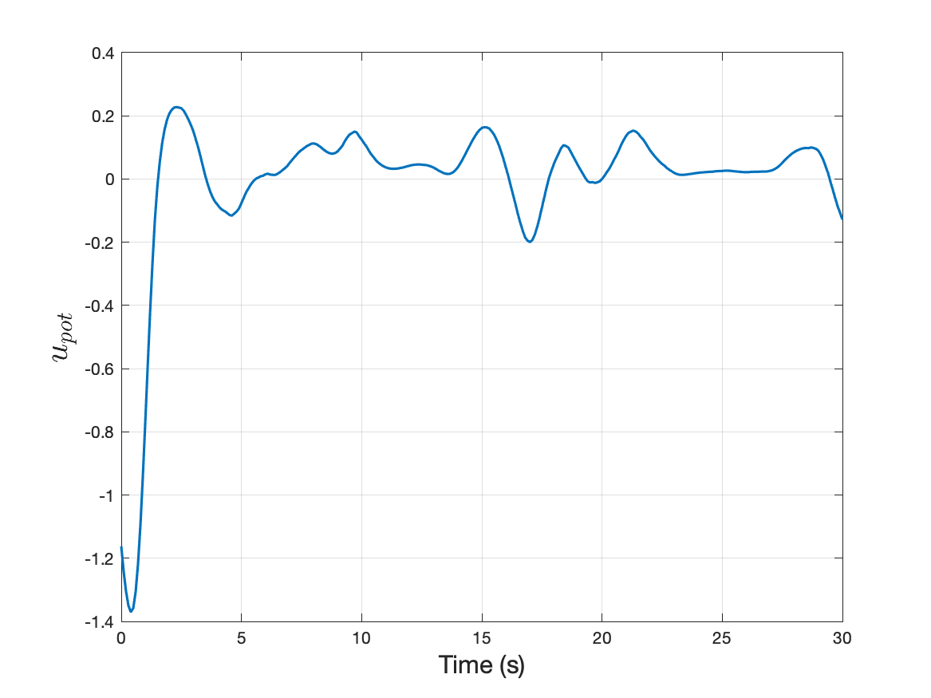
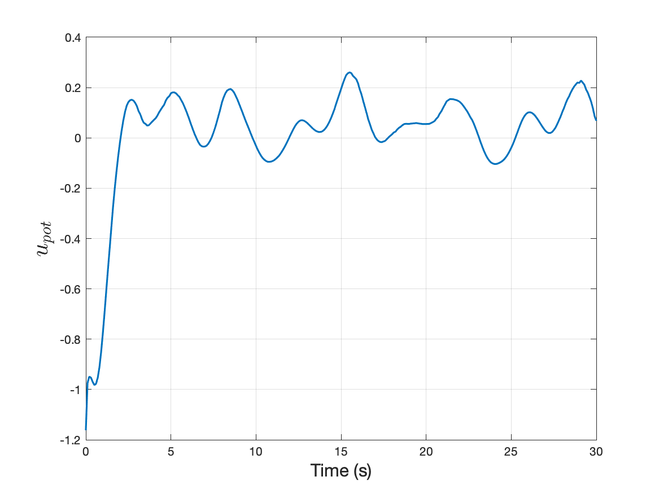
Person 1
Person 2
Projected repulsive potential
Person 3
Person 4

Slide 23
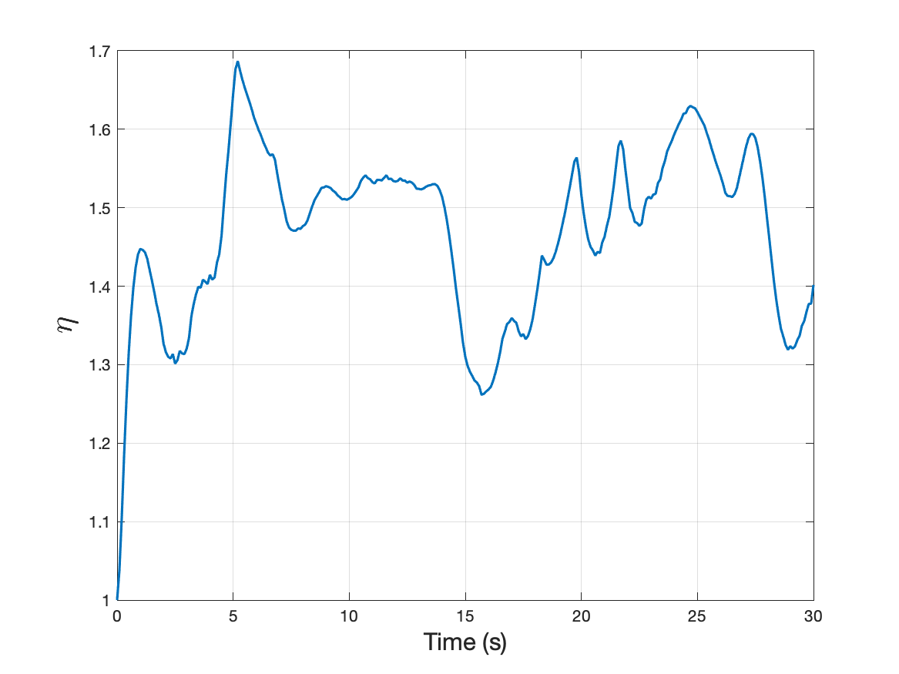
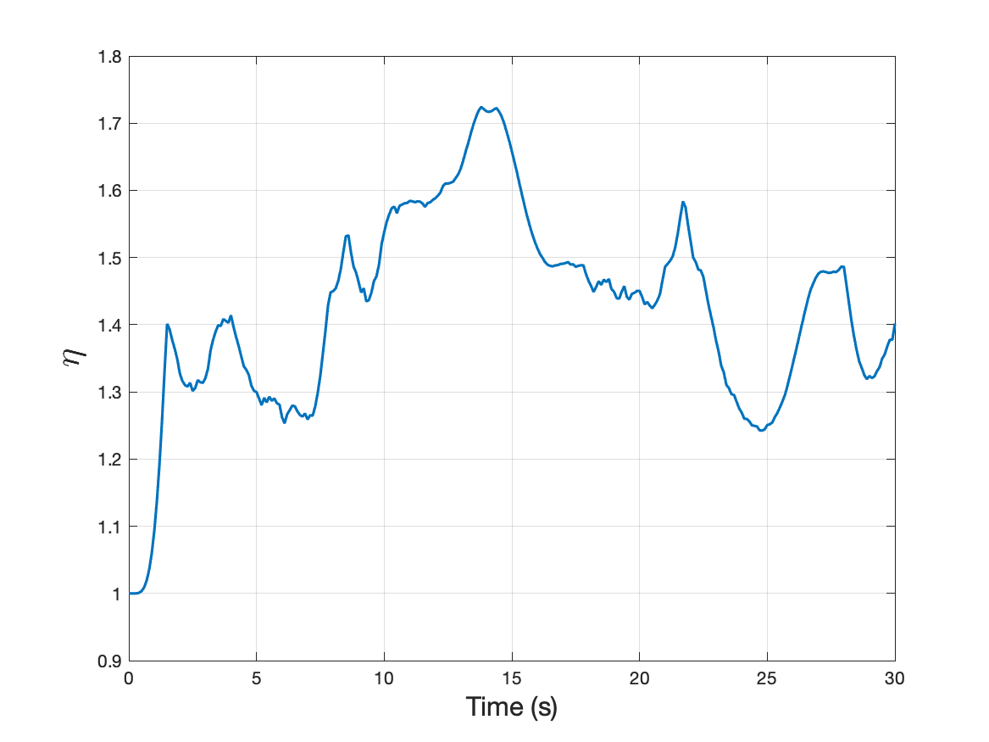
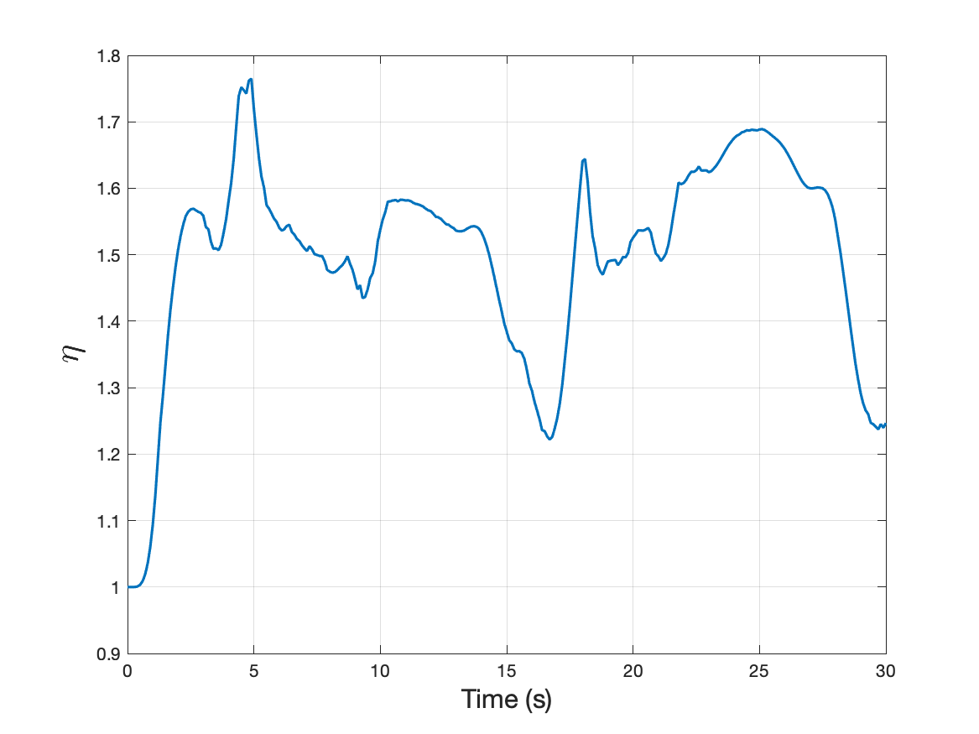
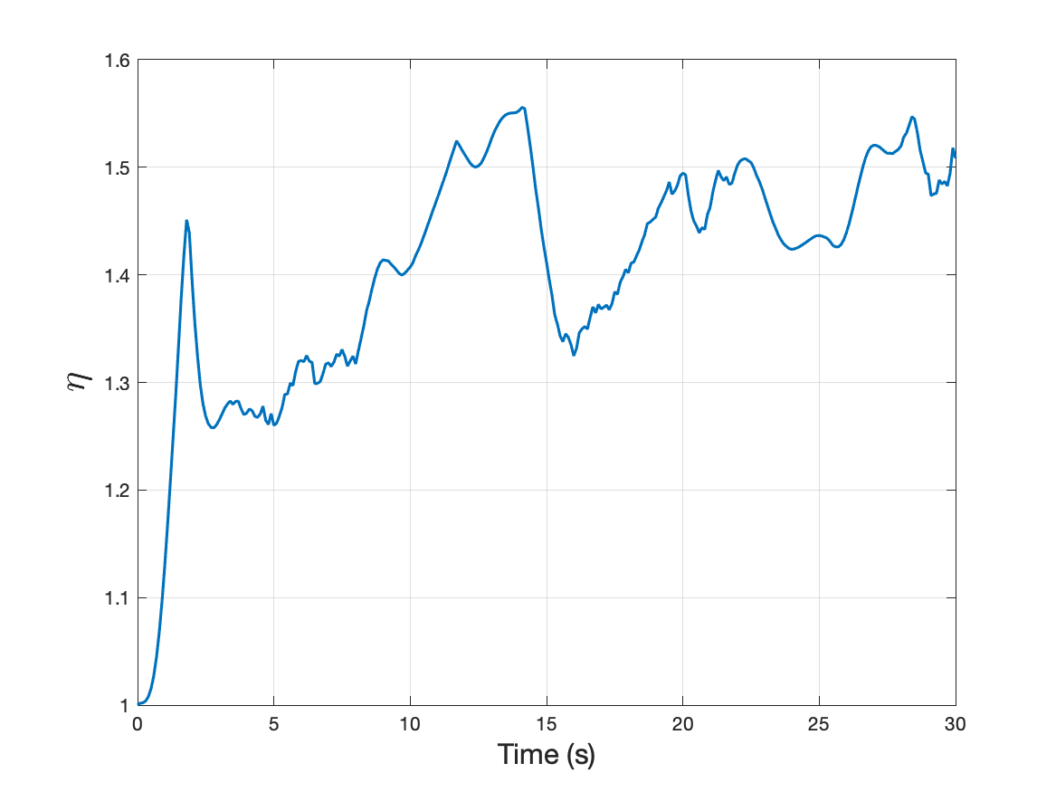
Person 1
Person 2
Clearance
Person 3
Person 4

Slide 24
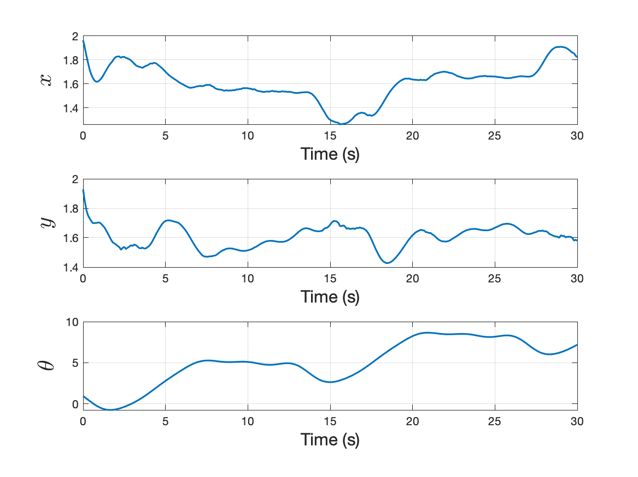
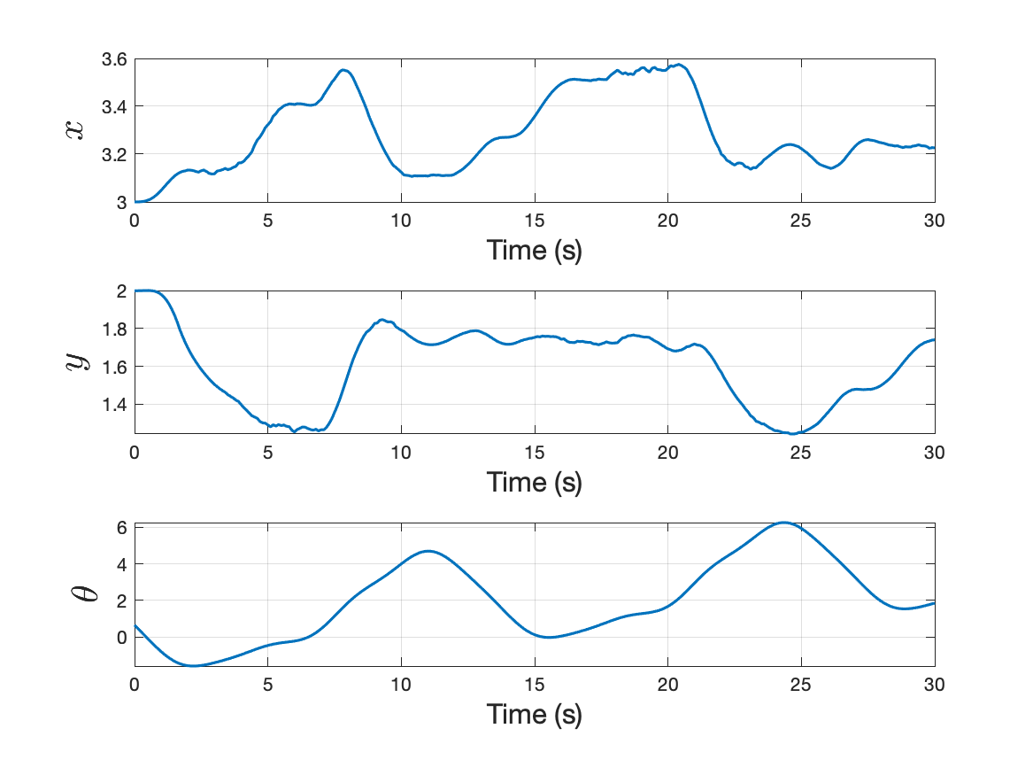
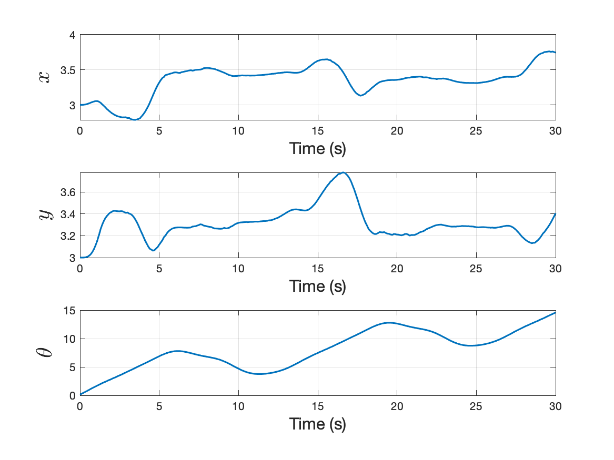
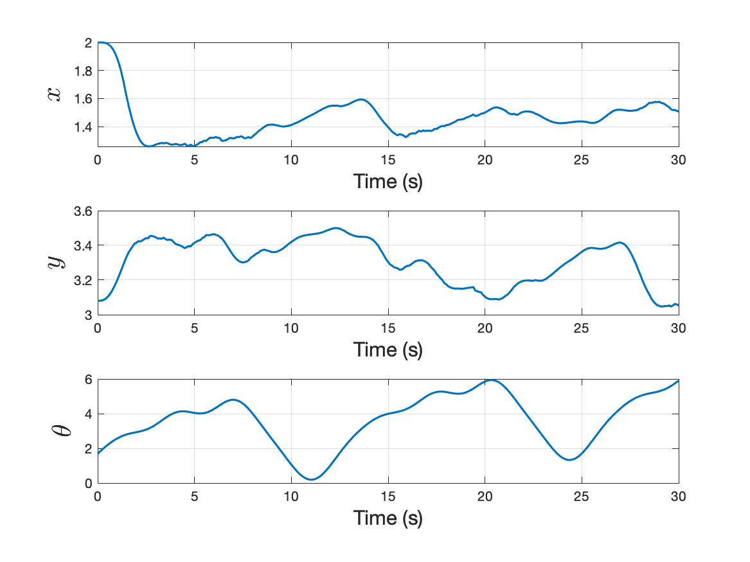
Person 1
Person 2
State
variables
Person 3
Person 4

Slide 25
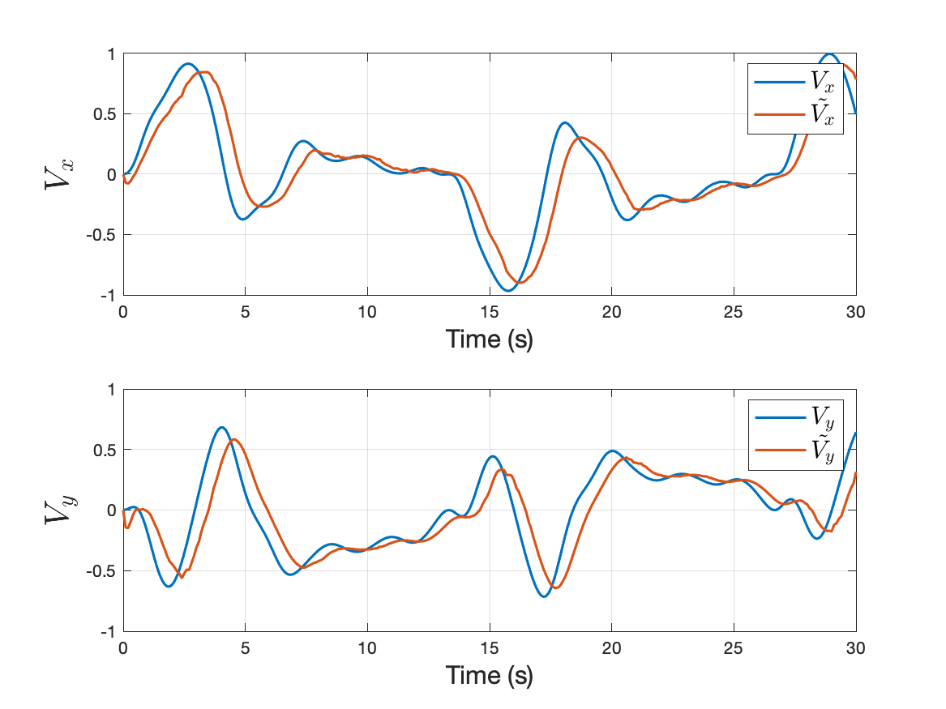
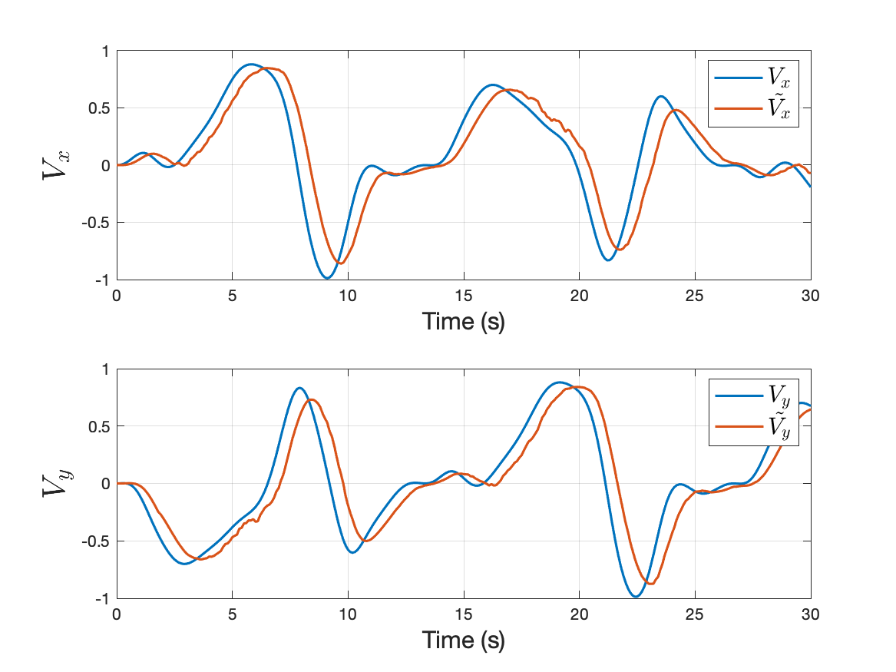
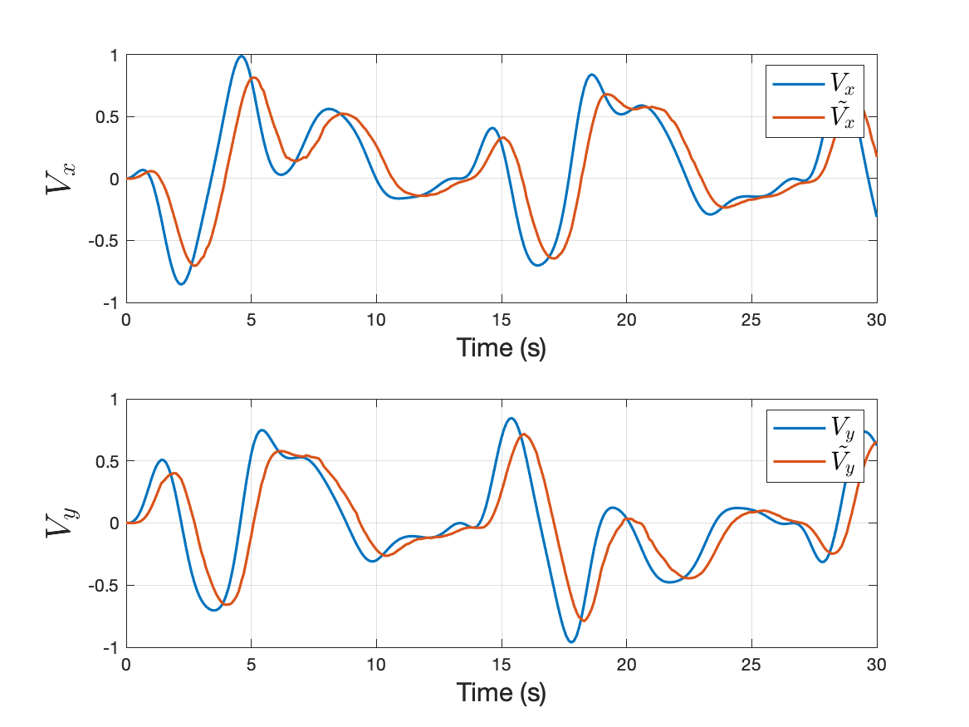
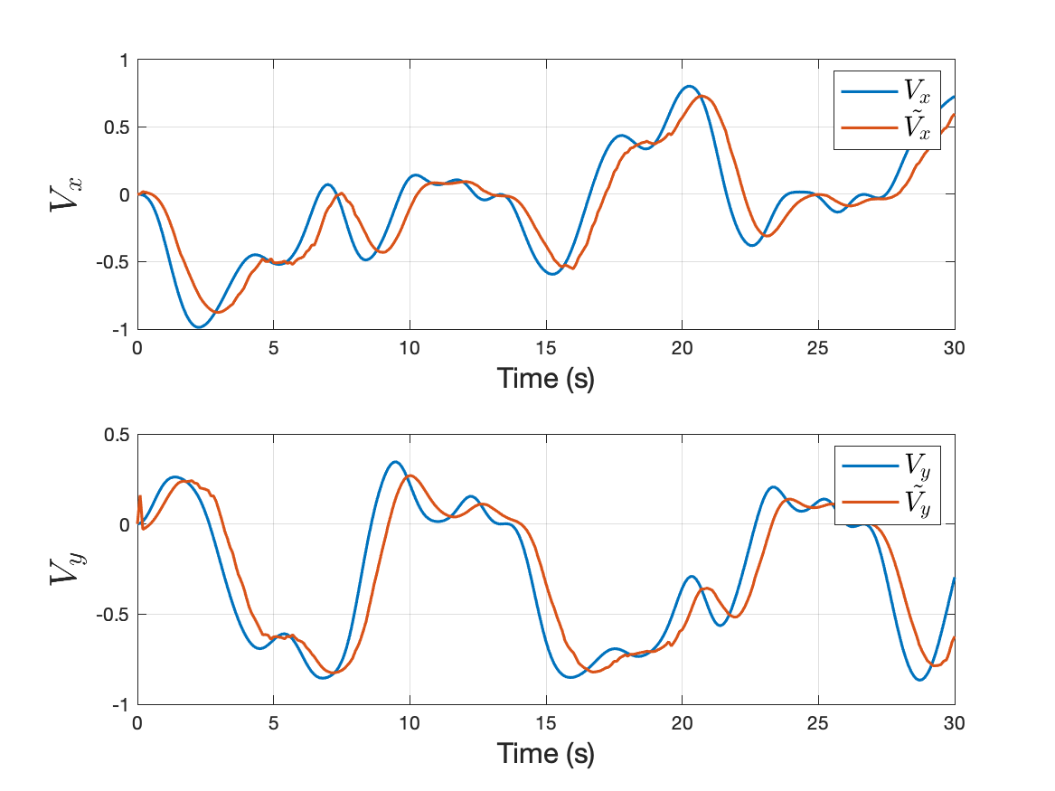
Person 1
Person 2
Intentional
velocity
Person 3
Person 4

Slide 26
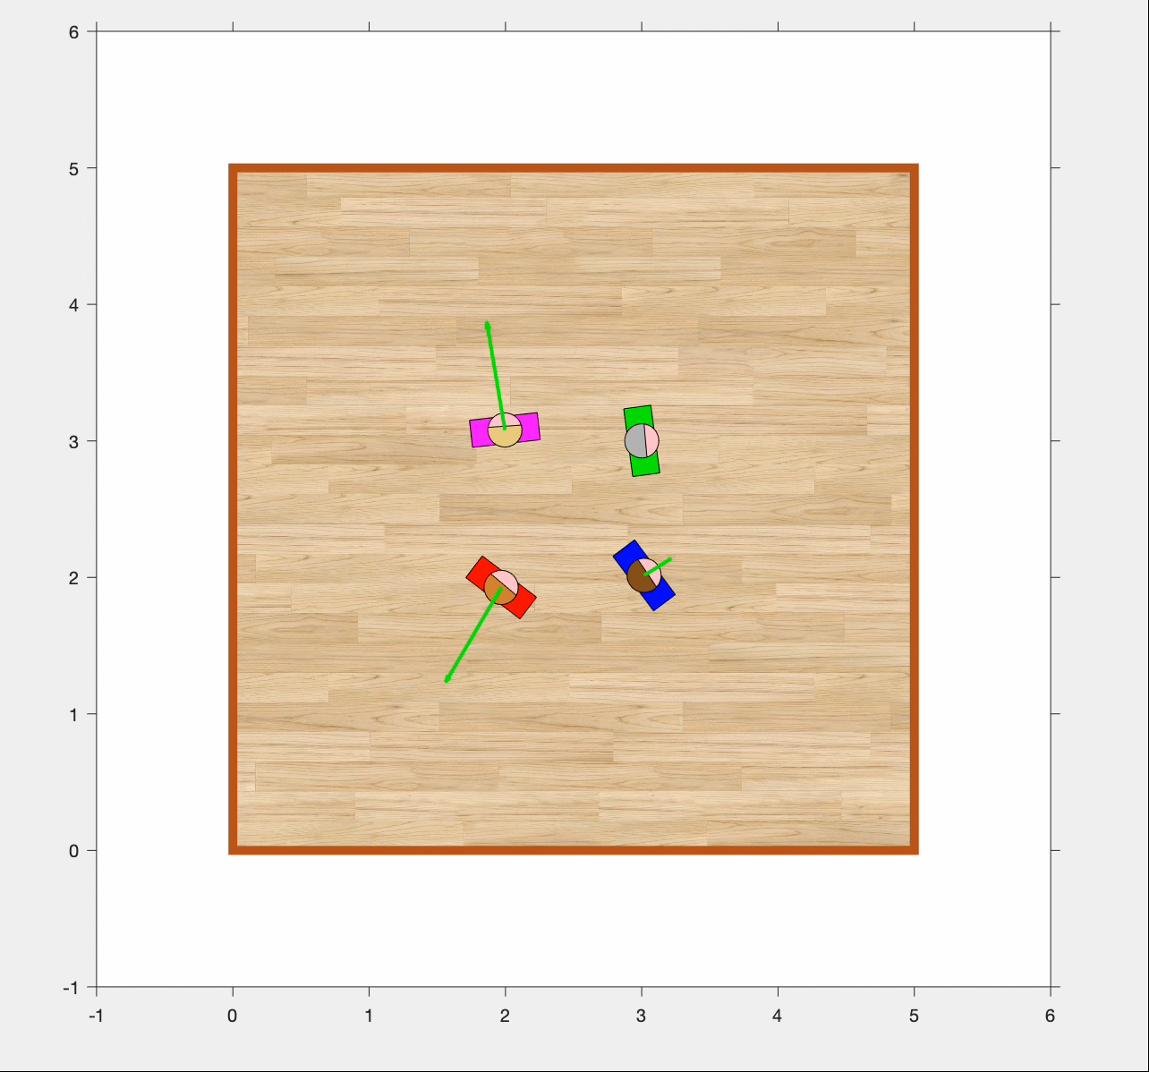
FOUR PEOPLE (with sensor noise)
To make things more challenging and realistic, we add sensor noise in the reading of the current position of each person.
In this case, the controllers and the observers are not perfectly aware of which is the real position of the users.
The intentional velocity trajectories and the initial positions are the same of the previous experiment.

Slide 27
Person 1
Person 2
Control
variables
Person 3
Person 4

Slide 28
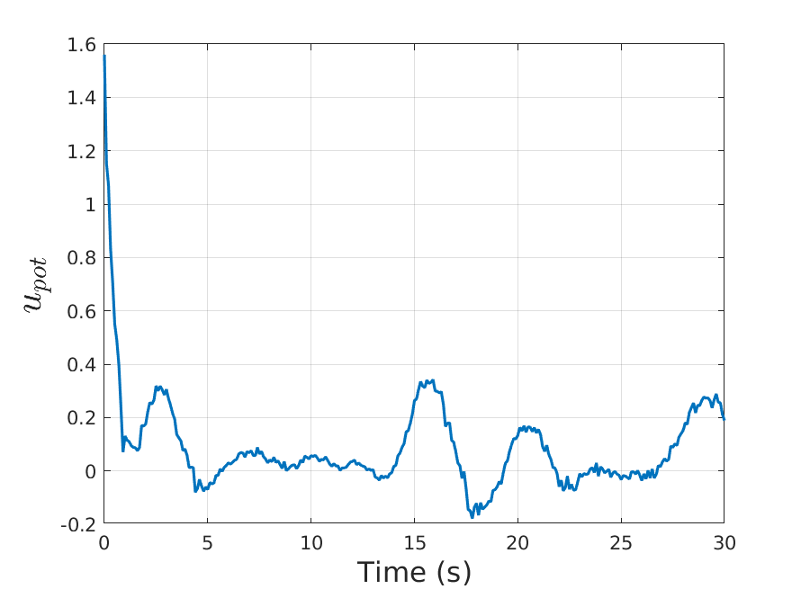
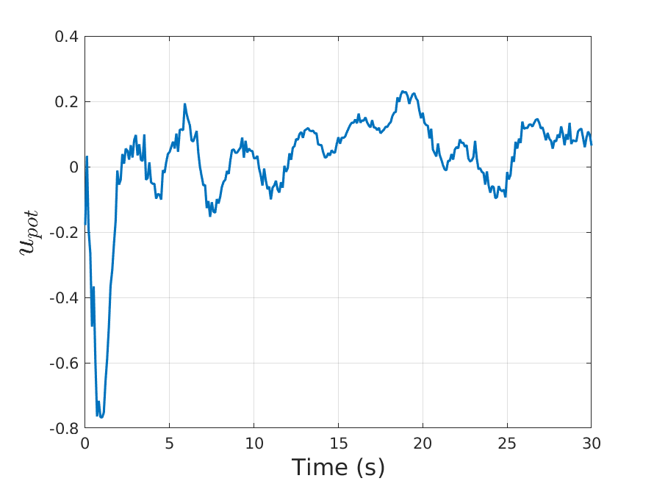
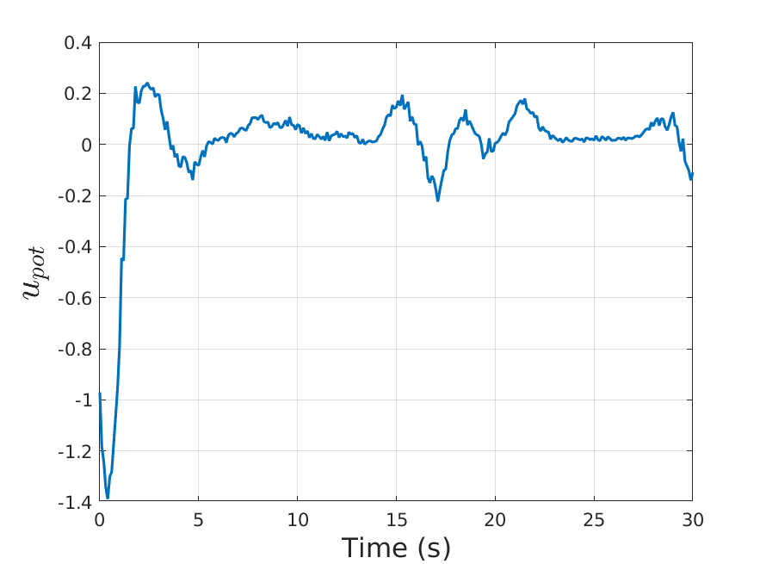
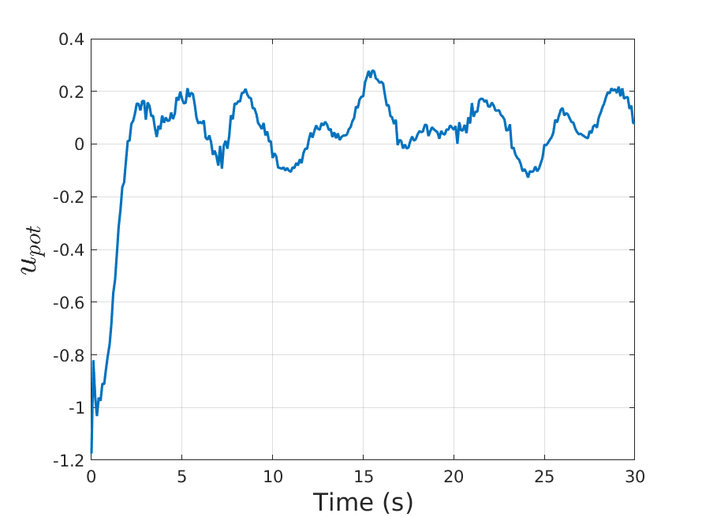
Person 1
Person 2
Projected
repulsive
potential
Person 3
Person 4

Slide 29
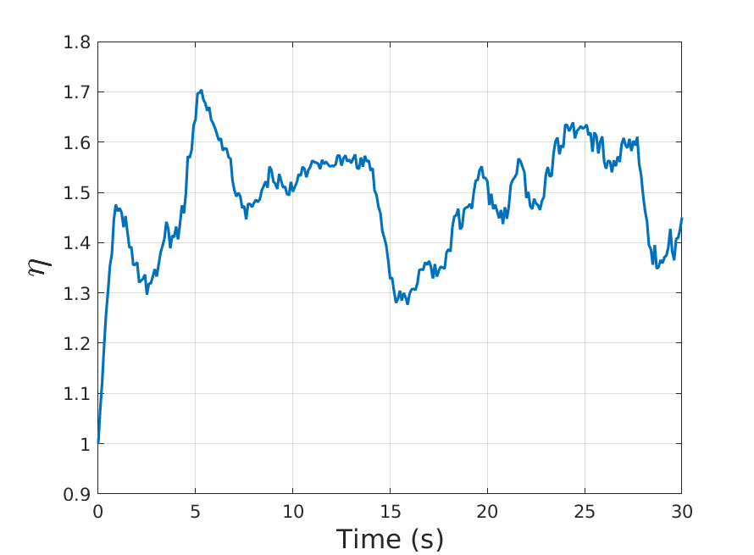
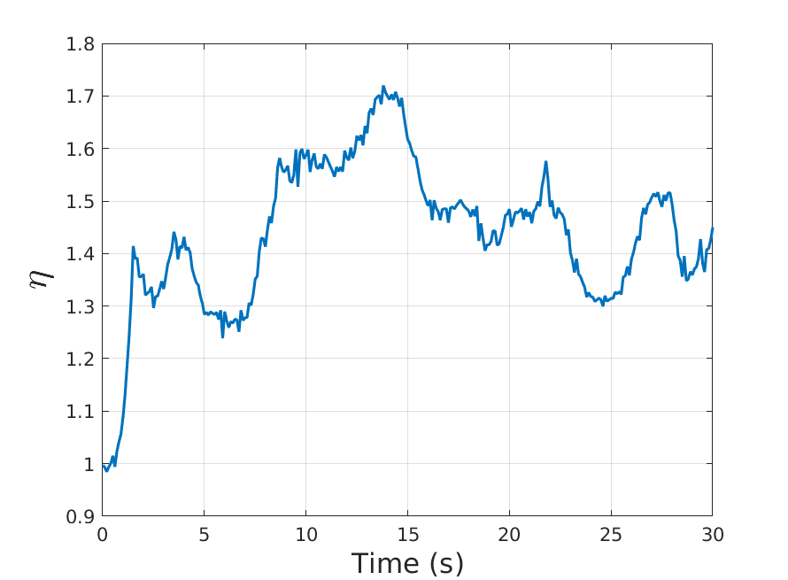
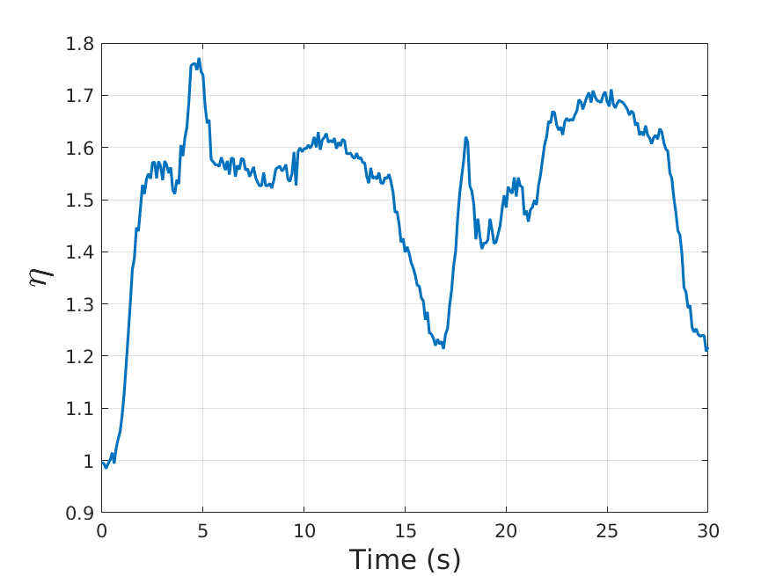
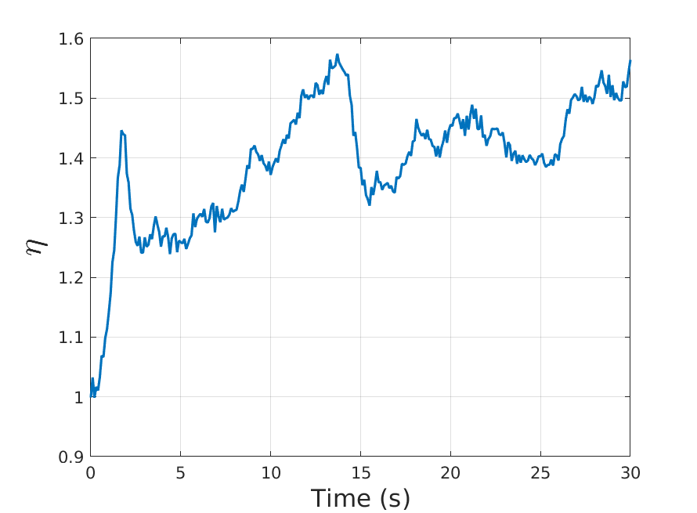
Person 1
Person 2
Clearance
Person 3
Person 4

Slide 30
Person 1
Person 2
State
variables
Person 3
Person 4

Slide 31
Person 1
Person 2
Intentional
velocity
Person 3
Person 4

Slide 32
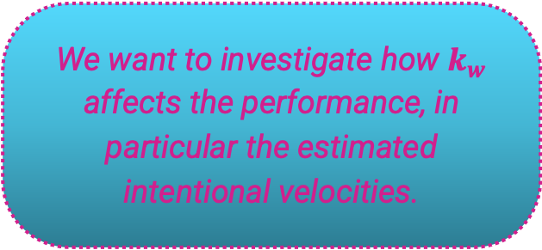
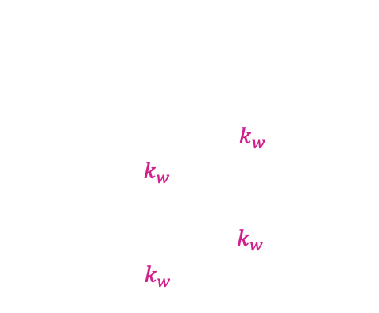
k_{w} TUNING
It is a parameter which appears in the equations of the observer:
$$\dot{ξ_{x}}=−v\cos{θ}+k_{w}(x−ξ_{x})$$
$${\tilde{V}}_{w,x}=k_{w}(x−ξ_{x})$$
$$\dot{ξ_{y}}=−v\sin{θ}+k_{w}(y−ξ_{y})$$
$${\tilde{V}}_{w,y}=k_{w}(y−ξ_{y})$$
We want to investigate how $k_{w}$ affects the performance, in particular the estimated intentional velocities.

Slide 33

k TUNING
1
2
w
$$k_{w}=1$$
3
4

Slide 34

k TUNING
1
2
w
$$k_{w}=2$$
3
4

Slide 35

k TUNING
1
2
w
$$k_{w}=5$$
3
4

Slide 36

k TUNING
1
2
w
$$k_{w}=7$$
3
4

Slide 37

k TUNING
1
2
w
$$k_{w}=10$$
3
4

Slide 38

k TUNING
1
2
w
$$k_{w}=2$$
3
4

Slide 39
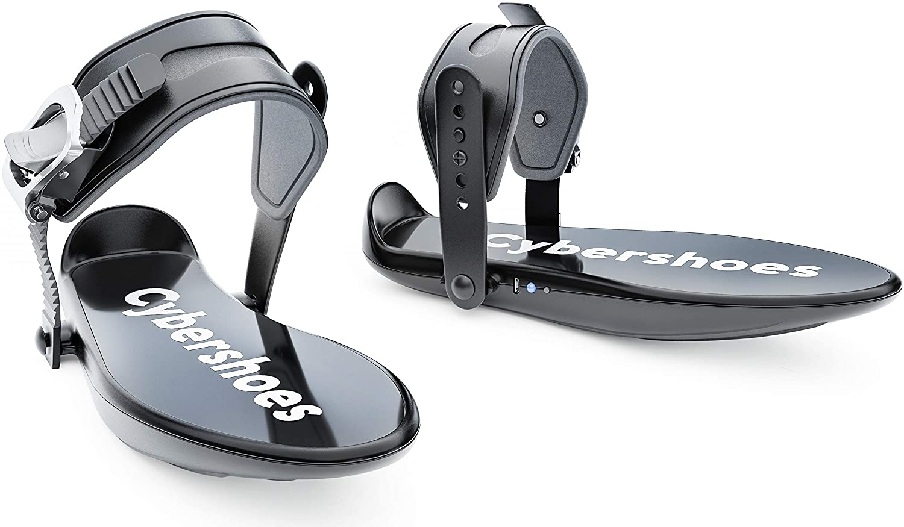
CONCLUSION
Powered Shoes are a locomotion mechanism that provide the sense of walking in virtual environment applications.
They allow multiple users to be in the same room without colliding against other or hitting the walls.
High accuracy in the position measurements is needed; the controller needs to understand the relative position of the user with respect to the others and to the walls.
The controller is able to compensate only for the longitudinal direction.
Drawbacks
… But in our work, the users are able to avoid each other and the walls though a velocity-level decentralized controller based on Artificial Potential Field.

Slide 40

THANK YOU FOR LISTENING

